Slide 1
GP PATIENT SURVEY 2024 (ICS & NATIONAL) Published: 11th July 2024
COMPARISON BETWEEN
SHMC - 476 Surveys sent > 88 replied > 18% completion rate
EPMC - 376 Surveys sent > 90 replied > 24% completion rate
CHARNWOOD - 452 Surveys sent > 111 replied > 25% completion rate

Slide 2
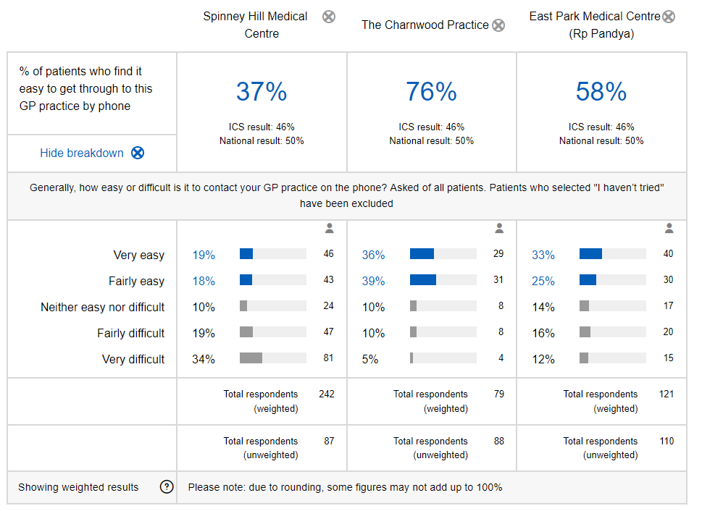

Slide 3
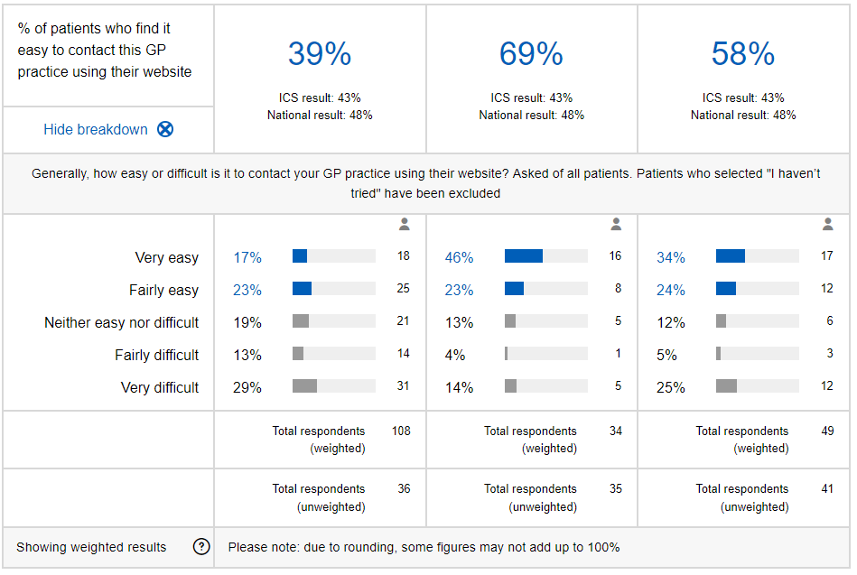

Slide 4
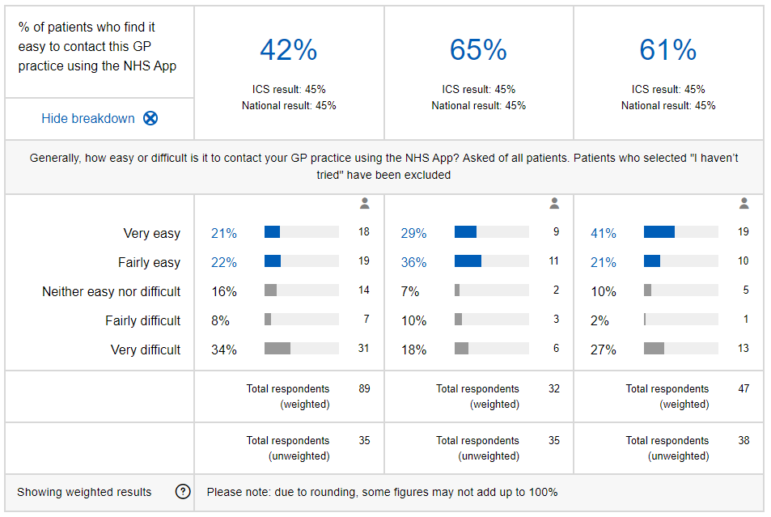

Slide 5
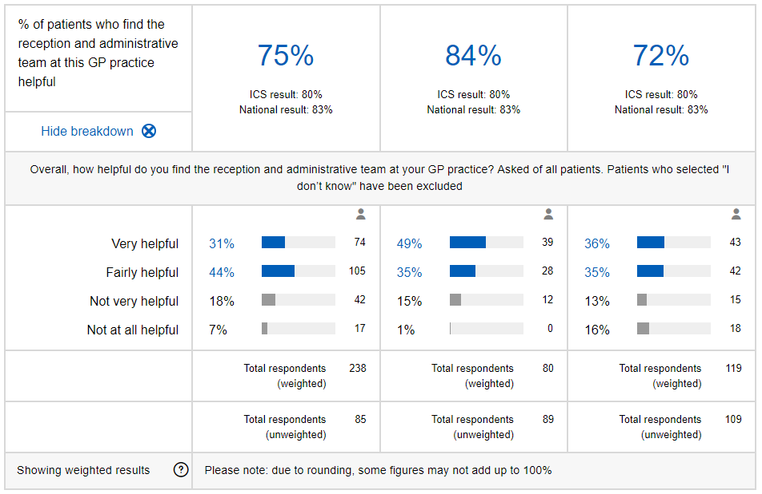

Slide 6
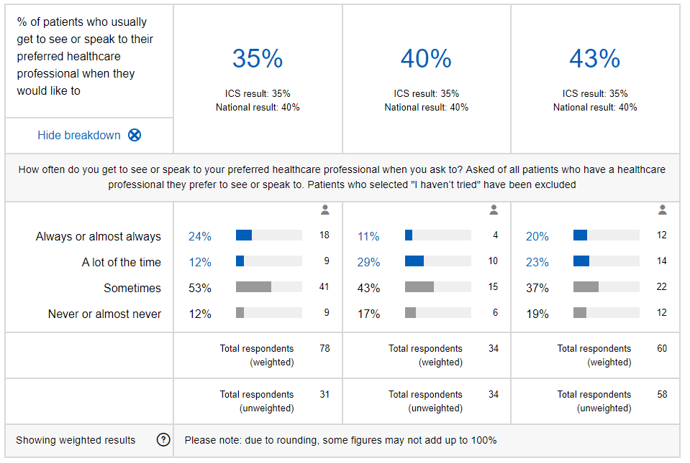

Slide 7
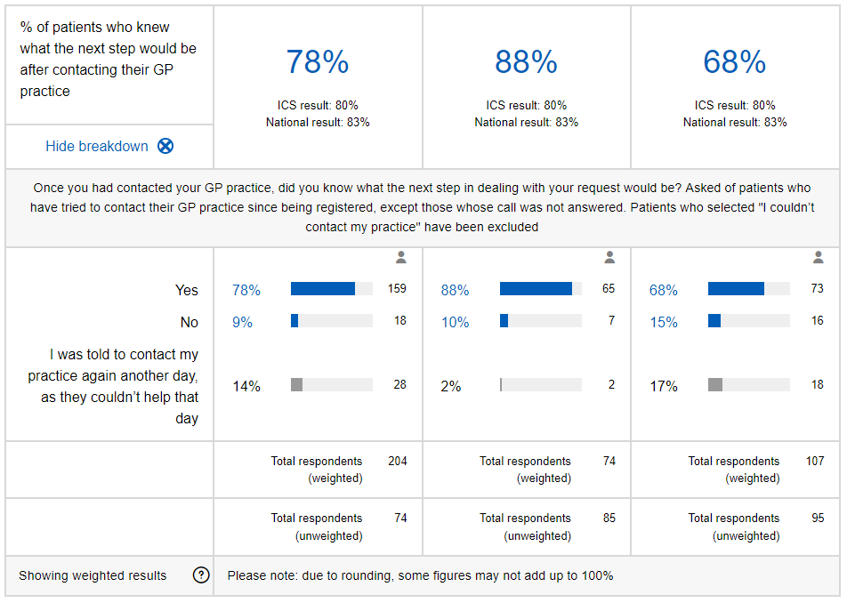

Slide 8
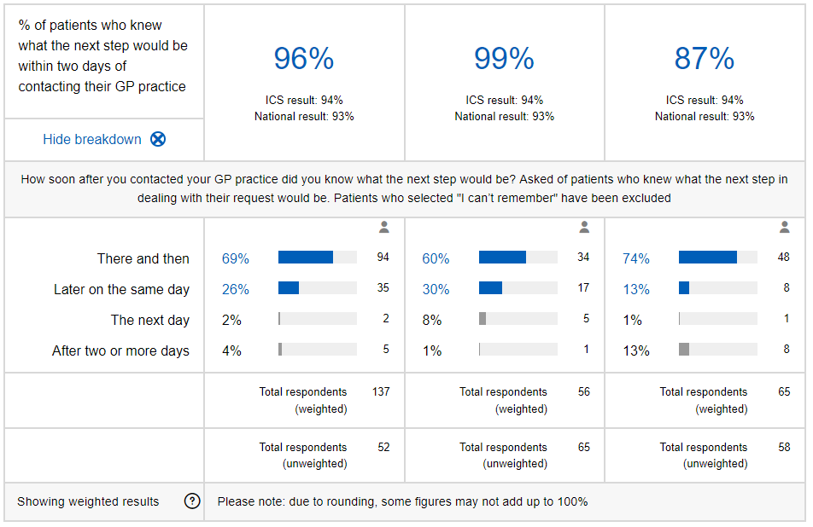

Slide 9
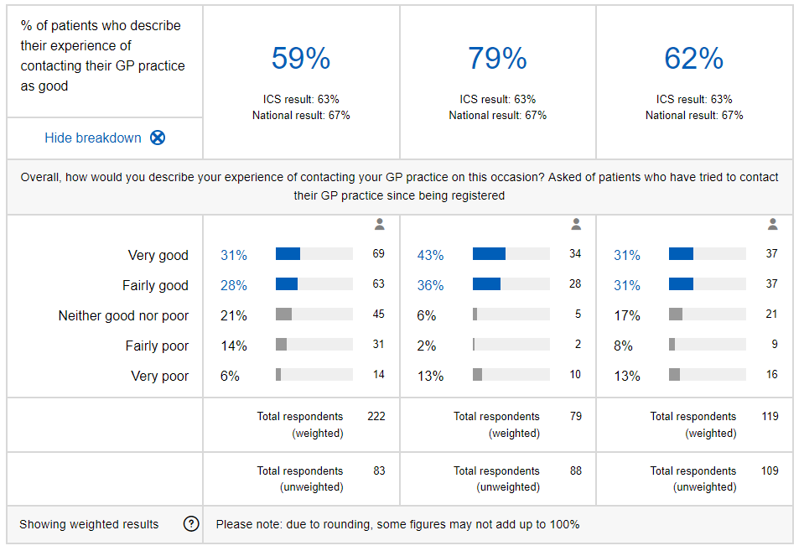

Slide 10
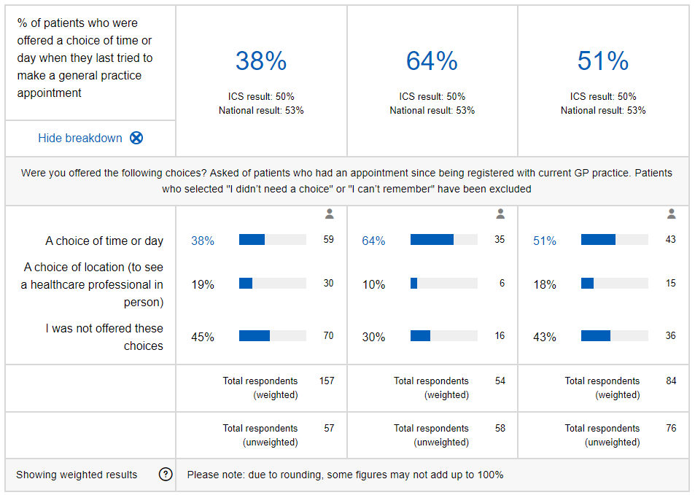

Slide 11
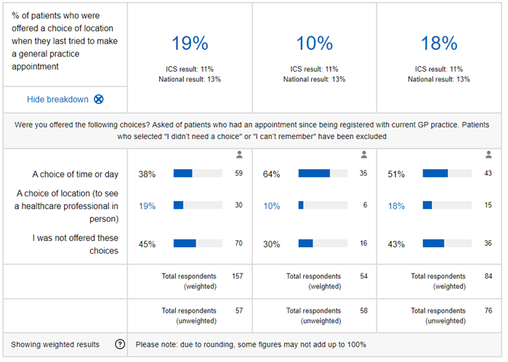

Slide 12
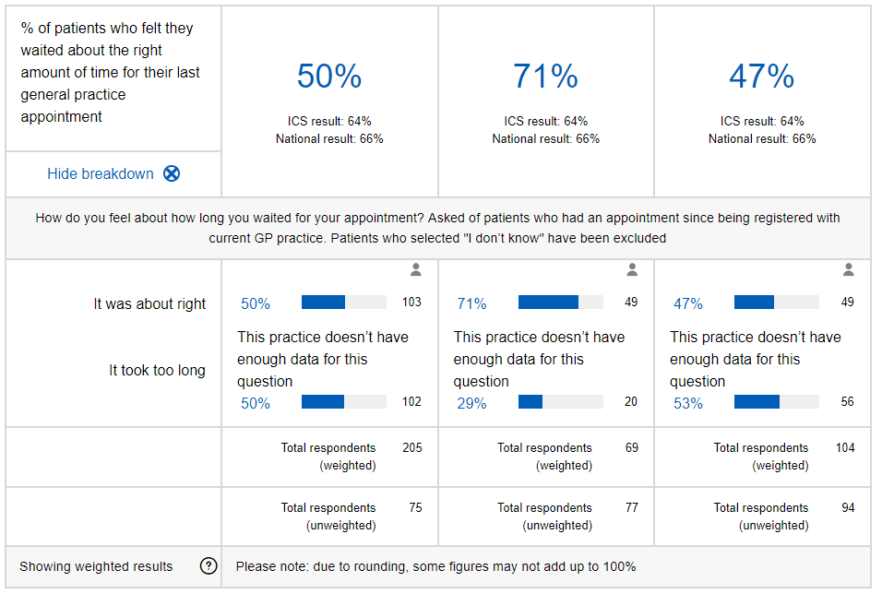

Slide 13
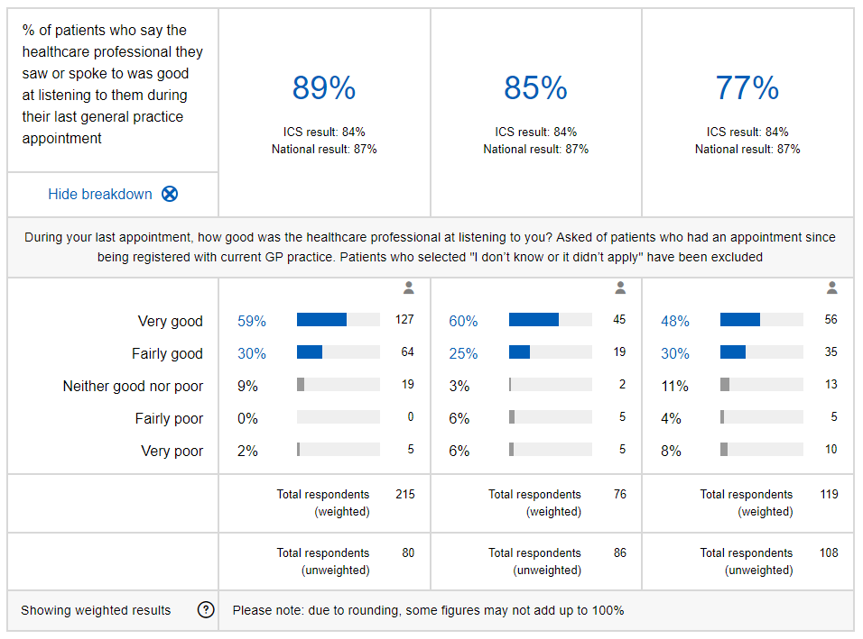

Slide 14
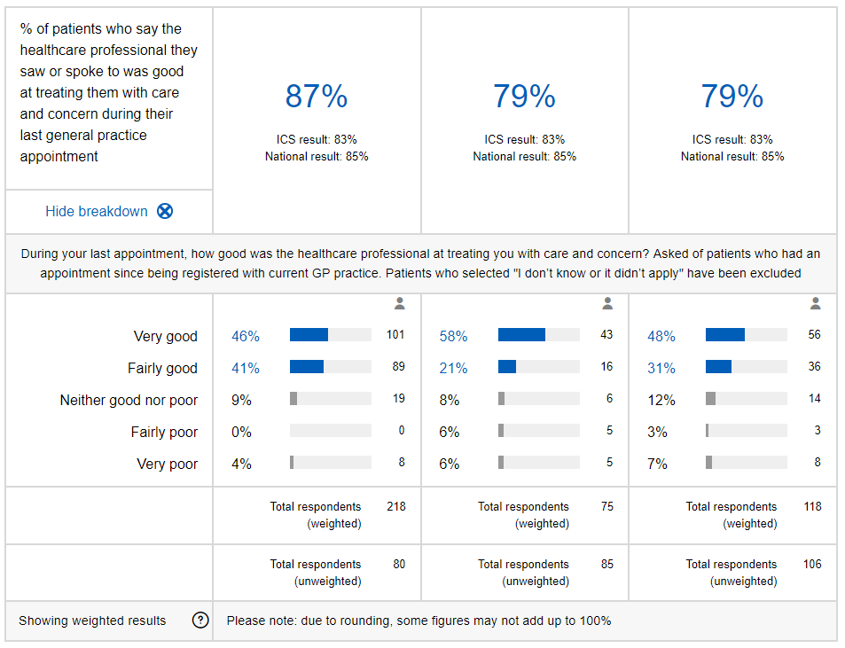

Slide 16
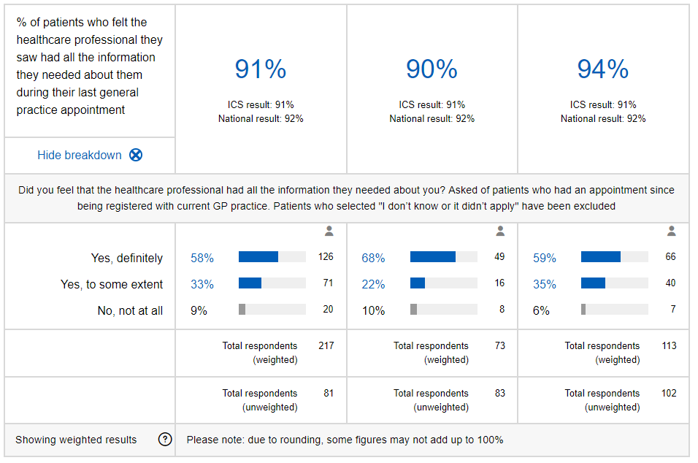

Slide 17
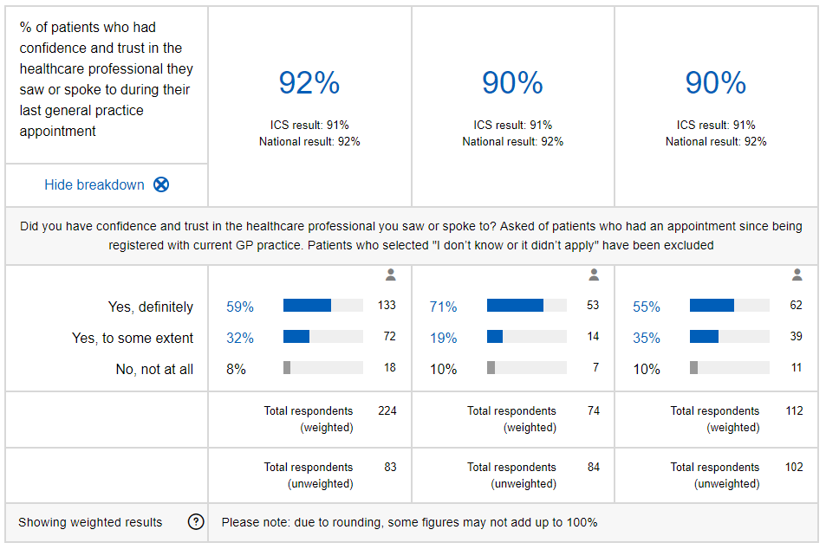

Slide 18
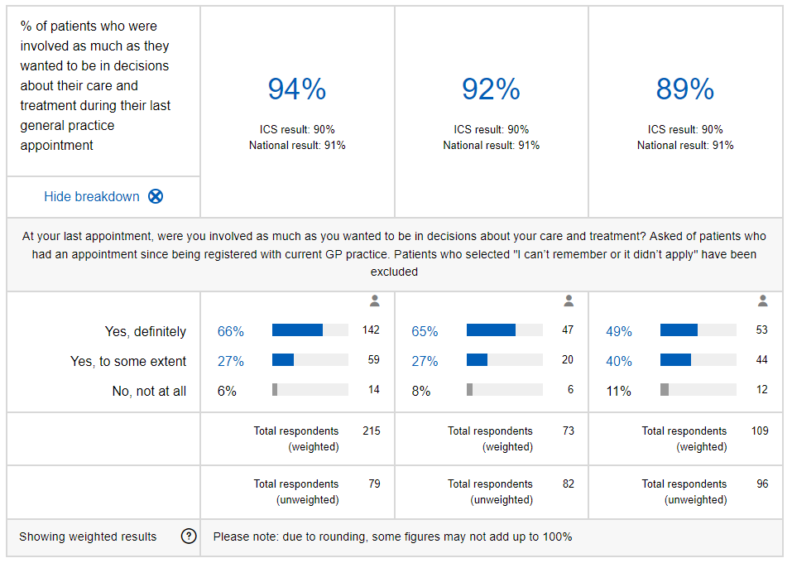

Slide 19
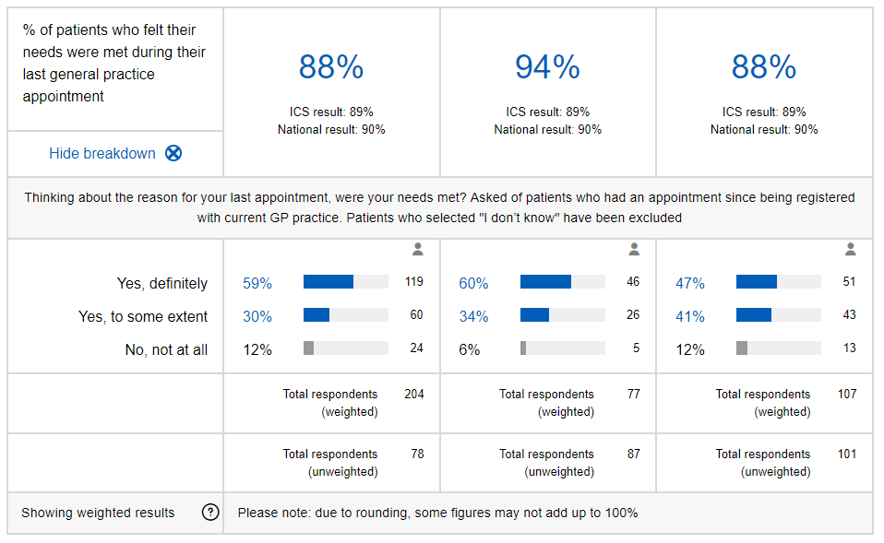

Slide 20
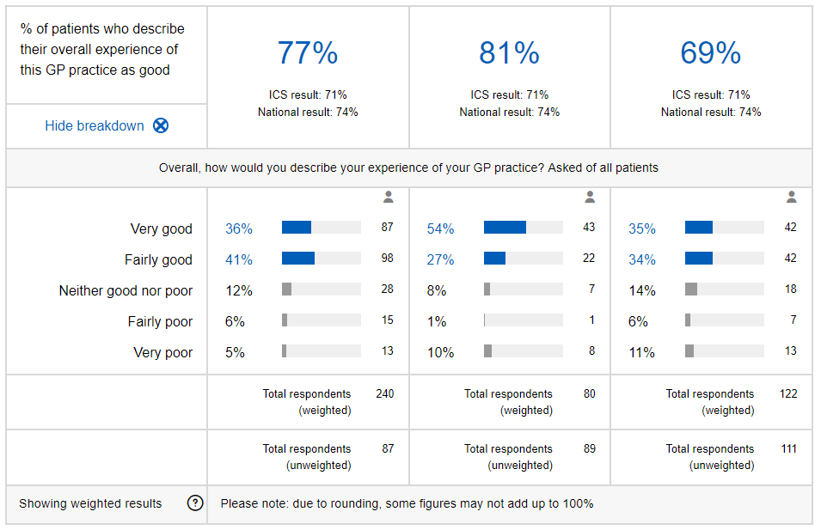
OVERALL EXPERIENCE

Slide 21
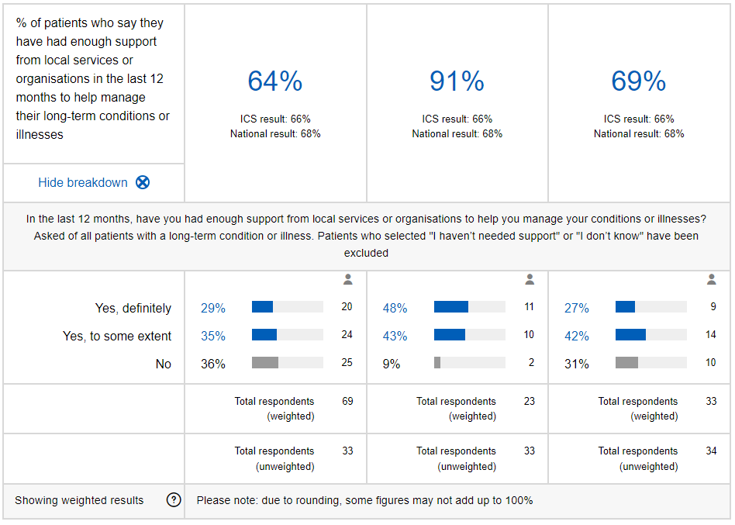
YOUR HEALTH SUPPORT

